Slide 1
Member advantage
Member support
Member cover
Member protect
Member development

Slide 2
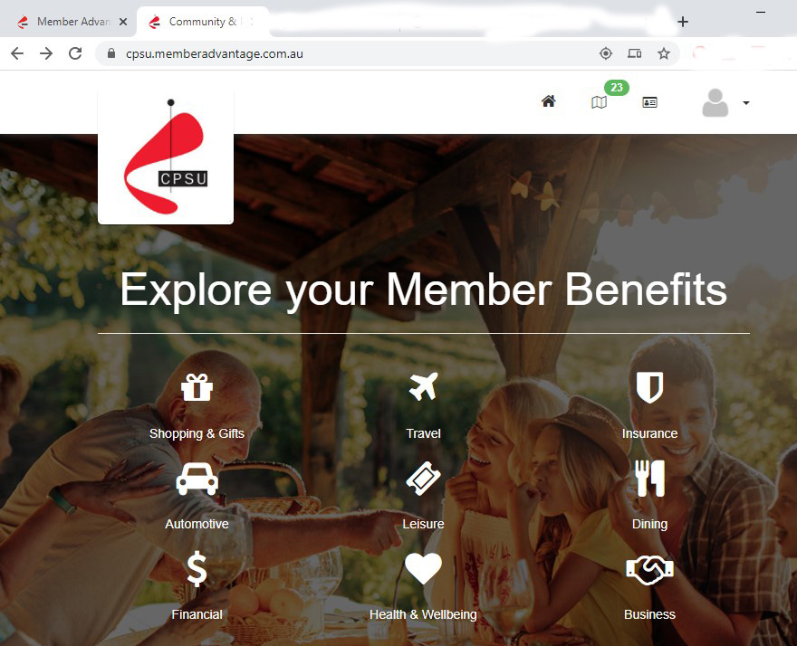
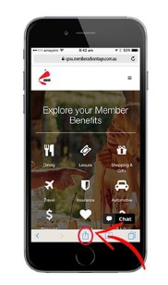
Member advantage
Comprehensive suite of benefits, discounts and special offers
Categories include shopping and retail, dining and leisure, health and wellbeing, travel and automotive, insurance, financial and business services
Easy to use online portal, supports mobile devices

Slide 3
Member advantage
Shopping and retail benefits include access to discount gift cards and special offers for groceries and petrol, clothing and footwear, cosmetics, electronics, homewares and whitegoods
Providers include Woolworths, Coles, Myer, David Jones, Sephora, Priceline, The Good Guys, JB Hi-Fi, Harvey Norman and much more
Notes:
Log in and check the CPSU Member Advantage website for specific details on the discounts available. Please note some of the discount rates offered by specific partners can be subject to change.
Examples include:
Woolworths groceries – 4% discount via gift cards or e-gift cards – Caltex Fuel StarCash gift cards include 5% discount
Coles - 4% discount via gift cards or e-gift cards
Myer – 5% discount via e-gift cards
Sephora – 7% discount via e-gift cards
Liquorland, Vintage Cellars and First Choice Liquor - 5% discount via e-gift cards
Harvey Norman - 5% discount via e-gift cards
JB Hi-Fi - access to JB Hi-Fi Corporate Benefits Programme portal.
Examples included as per website November 2020.

Slide 4
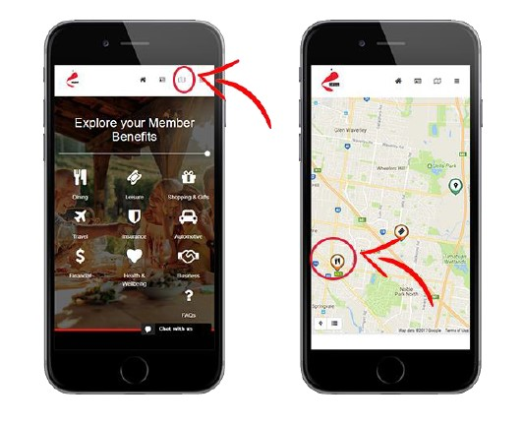
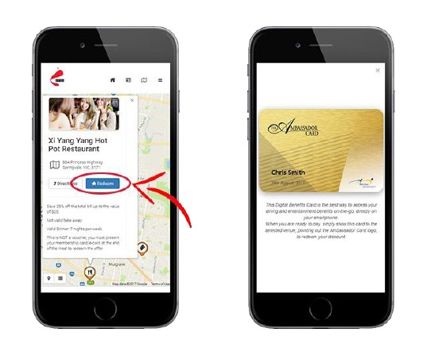
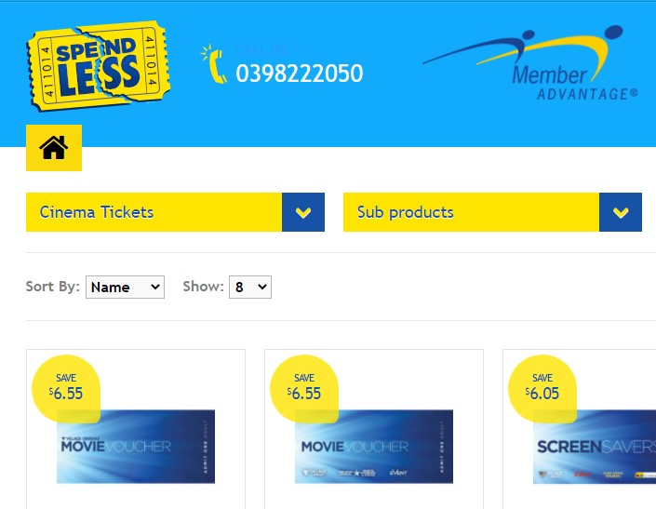
Member advantage
Food and dining discounts at up to 400 restaurants via Ambassador Card
Log into CPSU Member Advantage on mobile device and click on ‘Dining and Leisure Near Me’ to view a map of providers and display card on phone to redeem discount
Purchase discounted movie tickets and vouchers from Hoyts, Greater Union, Event, Village, Palace and more.

Slide 5
Member advantage
Health and wellbeing discounts for health insurance, glasses and optical, activewear, shoes and sports equipment as well as gym membership.
Partners include HCF, Specsavers, Lorna Jane, Rebel, Kathmandu, Foot Locker, Goodlife Health Clubs and Priceline
Notes:
Log in and check the CPSU Member Advantage website for specific details on the discounts available. Please note some of the discount rates offered by specific partners can be subject to change.
Examples include:
Specsavers – access to Corporate Club including 25% off 1 pair of glasses from the $149 range or above plus additional Hot Offers and promotions throughout the year
HCF - access to HCF's exclusive Corporate Product range
Lorna Jane – 7% discount via e-gift cards
Foot Locker – 7% discount via e-gift cards
Rebel – 7.5% discount via e-gift cards
Priceline - 10% discount via e-gift cards
Kathmandu - 7.5% discount via e-gift cards
Examples included as per website November 2020.

Slide 6
Member advantage
Travel deals for airline lounges, hotel and accommodation, group tours, travel gift cards,
Automotive benefits include car hire, insurance, vehicle buying service, salary packaged leases
Insurance, financial and business services. Credit cards, home loans, financial planning and insurance products.
Notes:
Log in and check the CPSU Member Advantage website for specific details on the discounts available. Please note some of the discount rates offered by specific partners can be subject to change.
Examples include:
Qantas Club - Discounted corporate rates are available for 1 and 2 year renewals and new memberships
Jetstar - 2.5% discount via e-gift cards
Hertz - Reduced Excess and Set Corporate Rates or 10% off the daily rate
Examples included as per website November 2020.

Slide 7
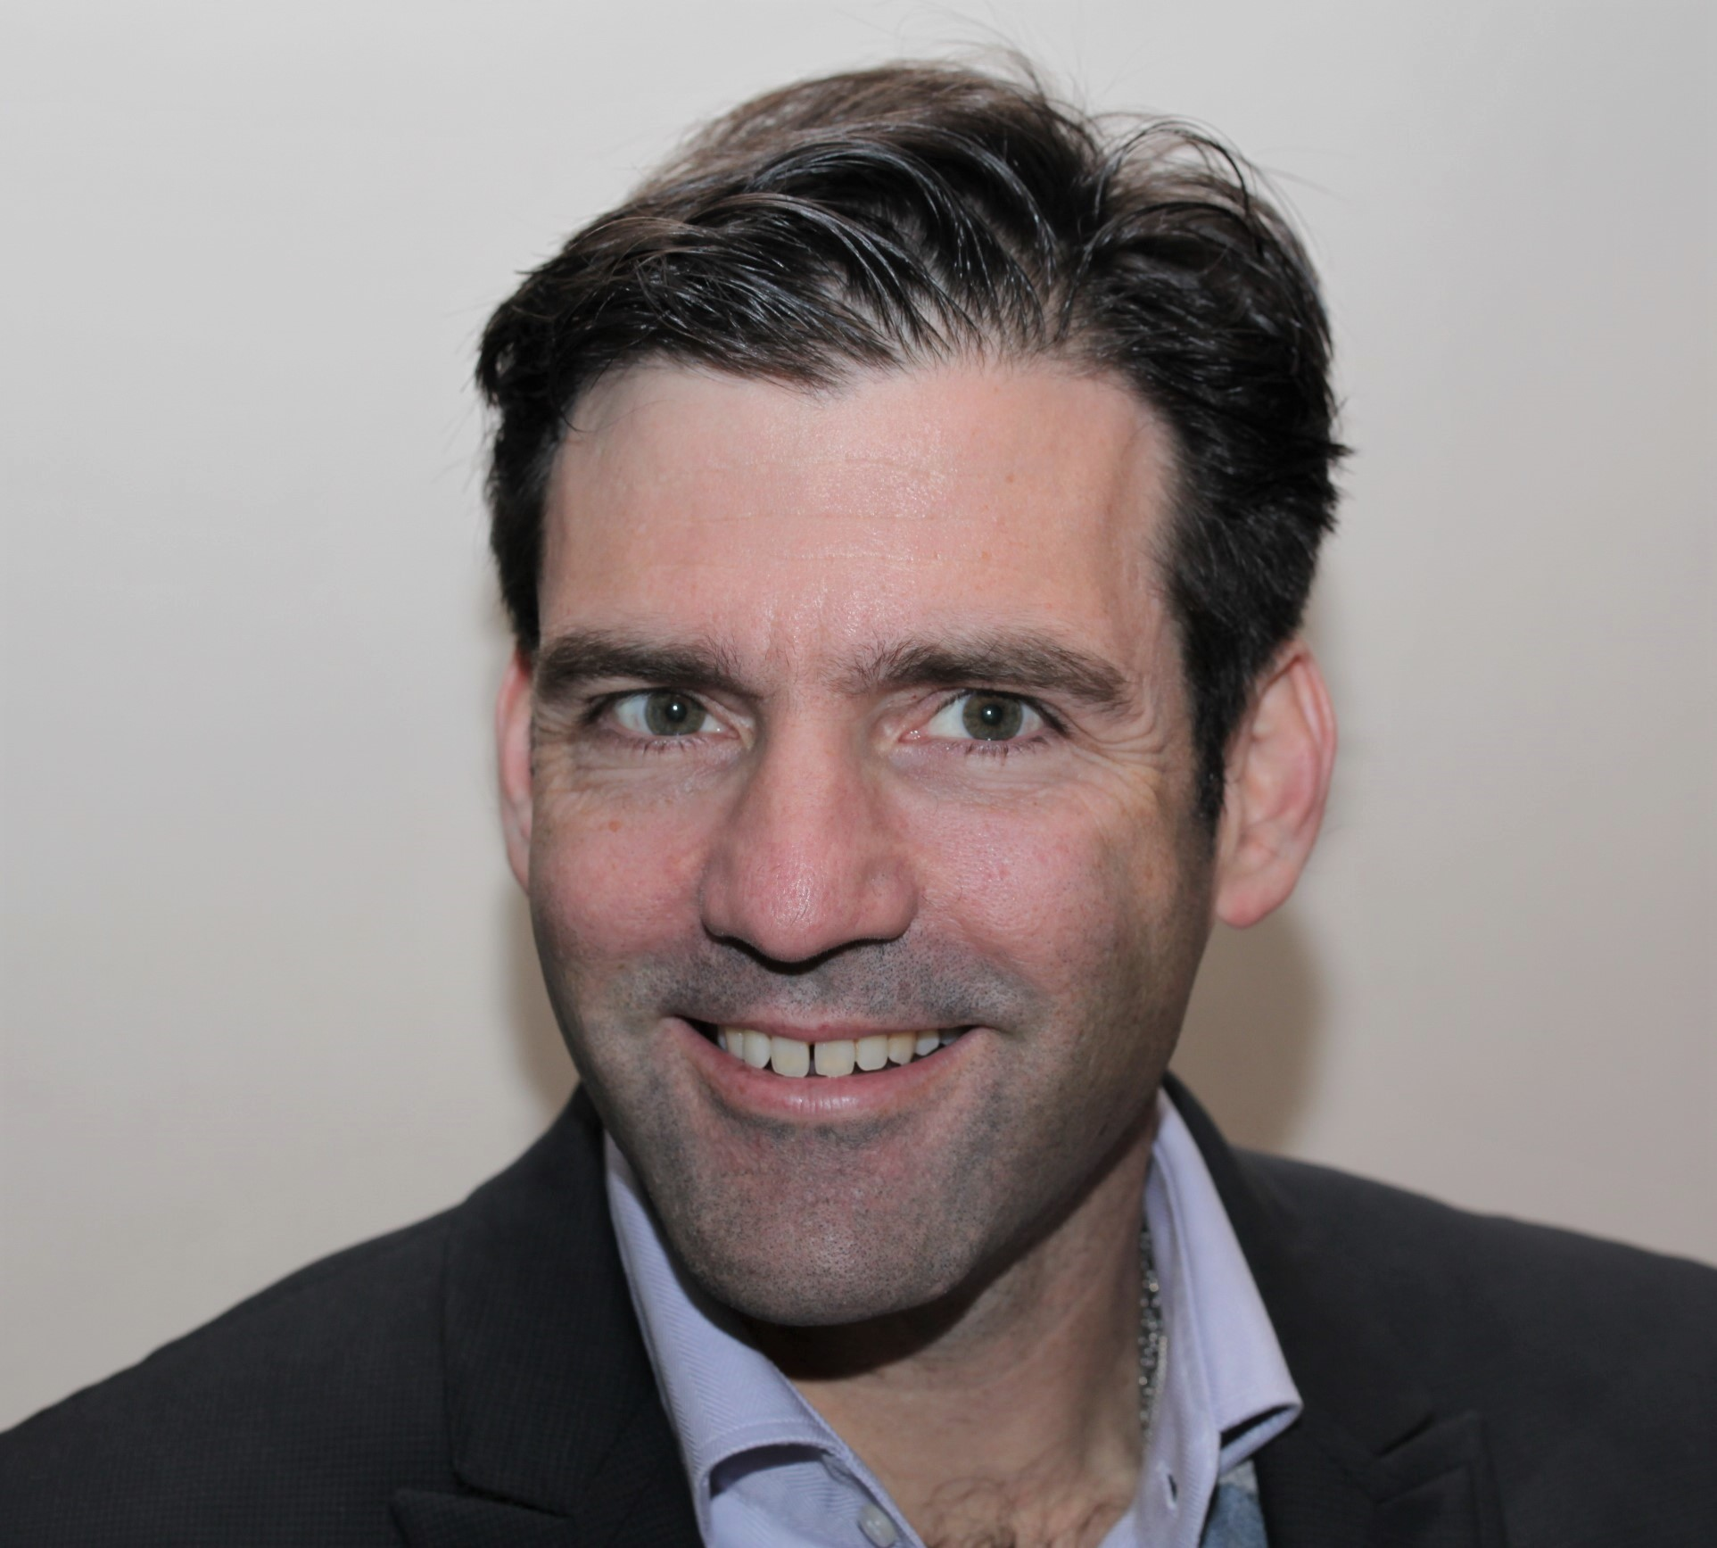
Member advantage
Testimonial: Nick Burke, CSIRO Victoria
“I’m a Union member because I know our collective voice is louder than any individual’s and I would be regardless of any other benefits, but I’m happy to make the most of some of the offers available to members.
“Many years ago when I was looking to buy a car I contacted Member Advantage, told them what I was looking for and a couple of days later they rang me back with the best price they could find, which happened to be the best price I could find. That five minute phone call saved me around $3000.
“More recently, I have been using e-gift cards to purchase groceries and fuel. There are discounts on all purchases made with e-gift cards bought through the Member Advantage program. It takes about 5 minutes to organise a card, which is emailed to you when it’s ready, and the discounts run into the hundreds of dollars a year.”

Slide 8
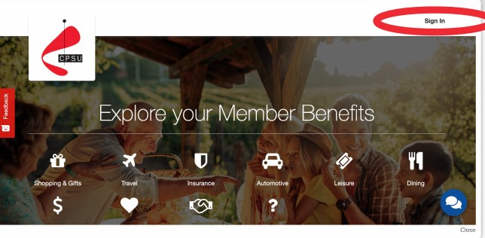
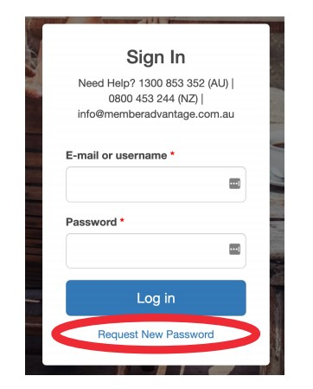
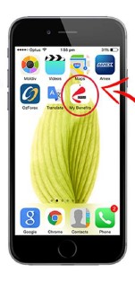
Member advantage
Desktop instructions
Visit cpsu.memberadvantage.com.au
Click sign in on the top right of page
Select request new password
Enter your email address
Click on e-mail new password
Use the link in the recovery email to log in and create a new password
Mobile instructions
Visit cpsu.memberadvantage.com.au
Click menu symbol on top right of page
Click on sign-in
Then sign in with log in details
Select share or menu then Add to Home Screen. Creates short cut for future access
Need help? Email cpsuweb@cpsu.org.au

Slide 9
Member advantage
Member support
Member cover
Member protect
Member development

Slide 10
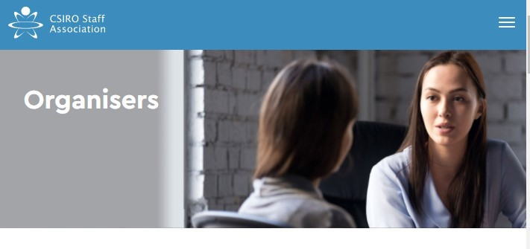
Member support
Members can get advice, analysis and representation for workplace issues
Staff Association delegates have training and experience supporting members in the workplace
Our organisers have expertise in workplace legislation and CSIRO policy for complex matters
For assistance visit csirostaff.org.au/about/our-people

Slide 11
Member advantage
Member support
Member cover
Member protect
Member development

Slide 12
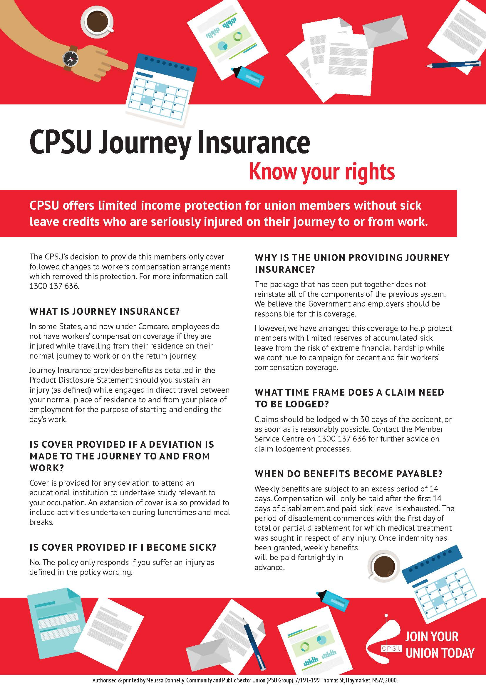
Member cover
CSIRO employees are not covered by workers’ compensation during travel to and from the workplace
However all Staff Association members receive free journey cover in the form of income protection insurance
If you have an accident and are seriously injured on your journey to or from the workplace and don’t have enough sick leave credits to cover time off work, the income protection insurance takes effect
Conditions apply. For more information visit csirostaff.org.au/benefits/journey-insurance

Slide 13
Member advantage
Member support
Member cover
Member protect
Member development

Slide 14
Member protect
Members receive a free legal referral to Slater+Gordon lawyers
Slater+Gordon are experts on employment law as well as conveyancing, wills and family law
Special rates are available to CPSU members
A free online will service is available
Union family bereavement benefit of $1,000 payable to the family of deceased members
For more information email csstaff@cpsu.org.au

Slide 15
Member advantage
Member support
Member cover
Member protect
Member development

Slide 16
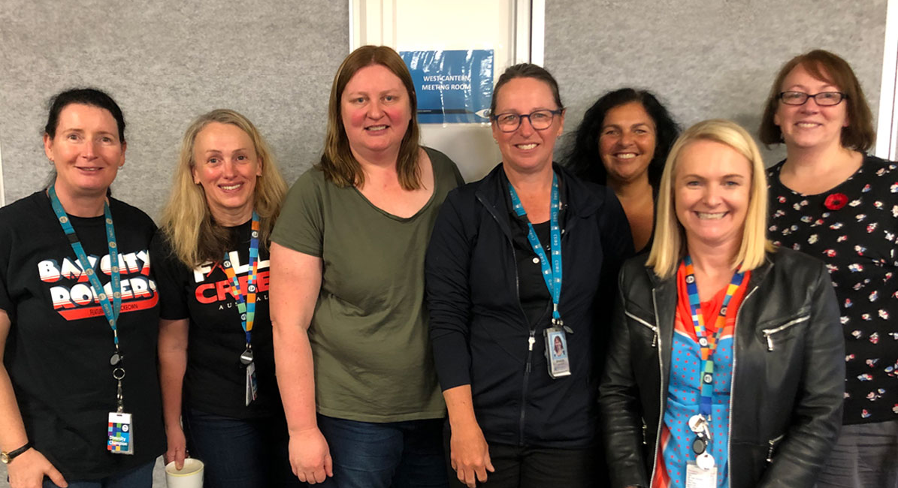
Member development
John Little (study) Scholarships support members who are undertaking study leading to the award of a formal qualification, and who are classified up to CSOF Level 3 Max in CSIRO.
The scholarships are $1,000 each and assist with the costs of study related expenses, including course fees and materials. Up to three scholarships are awarded each year.
Women in Science Careers Scholarships support the professional development of women in science careers at CSIRO by providing vertical networking opportunities, shadowing senior role models and/or mentoring programs.
The scholarships are to assist with the costs of travel, accommodation and sundry expenses. Up to $3,000 is awarded each year.
Eligibility rules apply. For more information visit csirostaff.org.au/resources/scholarships-awards

Slide 17
For more information
visit csirostaff.org.au/benefits
or email csstaff@cpsu.org.au

